Slide 1
Science Fiction
*https://www.youtube.com/watch?v=nrusqQ5JftA
Teacher explanation: https://www.youtube.com/watch?v=UIJtUH5tBpU
Maybe: https://www.youtube.com/watch?v=JI9lVkJdif4
Ted Talk: https://www.youtube.com/watch?v=9Ed8OeZcOBI

Slide 2
Flowers For Algernon
By Daniel Keyes

Slide 3
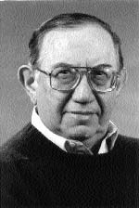
Daniel Keyes
Daniel Keyes was an American writer best known for his Hugo award-winning short story and Nebula award-winning novel Flowers for Algernon. Keyes was given the Author Emeritus honor by the Science Fiction and Fantasy Writers of America in 2000.
The story received so much attention that Keyes eventually turned it into a full-length novel.

Slide 4
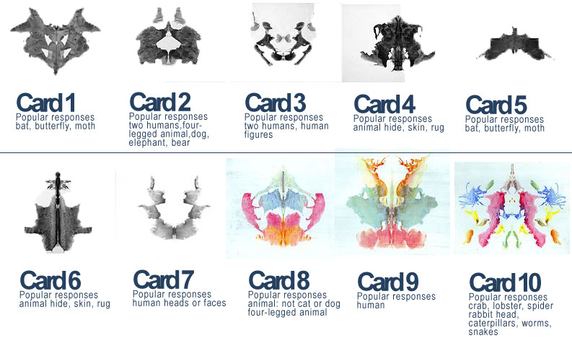
Rorschach test

Slide 5
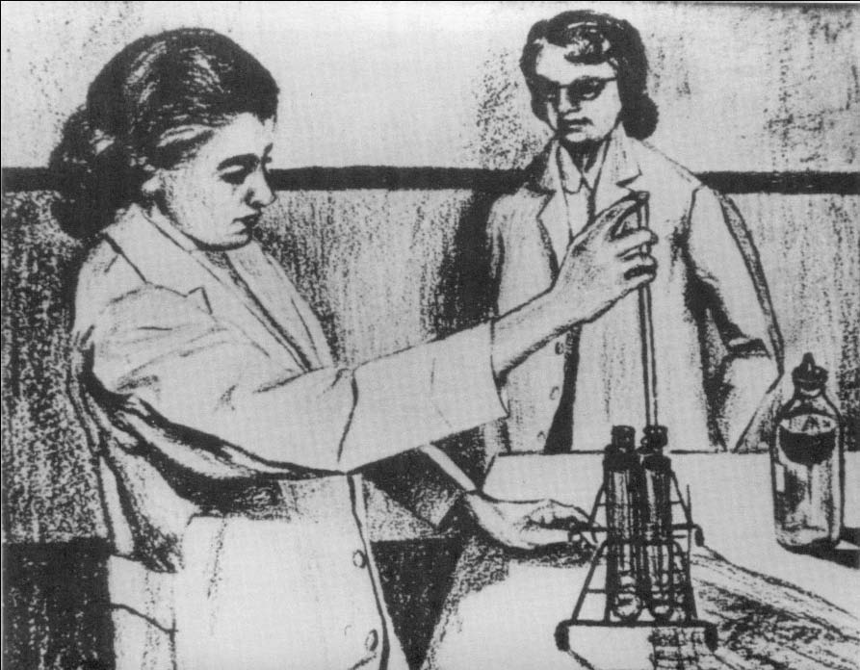
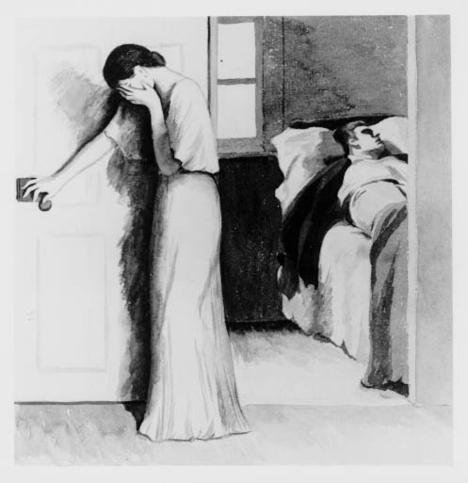
Apperception Test
In a TAT there are usually 30 cards (illustrations) to pick from and the participant chooses 5 of them to answer one of the following questions: what has led up to the event shown, what is happening at the moment, what the characters are feeling and thinking, what the outcome of the story was.

Slide 6
Apperception Test
In a TAT there are usually 30 cards (illustrations) to pick from and the participant chooses 5 of them to answer one of the following questions: what has led up to the event shown, what is happening at the moment, what the characters are feeling and thinking, what the outcome of the story was.
Did you assume that he’s dead and she’s grieving, upset because he’s drunk, or worried because she just killed him?
What might that
say about you?
Did you think this woman is making a breakthrough discovery? Then success is important to you.
Did you think these people are friends? Then relationships are more important to you?

Slide 7
Vocabulary
1. laboratory: a room or building equipped for scientific experiments, research, or teaching, or for the manufacture of drugs or chemicals.
2. unconscious: the part of the mind that is inaccessible to the conscious mind but that affects behavior and emotion
3. contribute: help to cause or bring about.
4. shrew: a bad-tempered or aggressively assertive woman.
5. maroon: to put ashore and abandon on a desolate island or coast by way of punishment or the like, as was done by buccaneers.
6. accomplish: achieve or complete successfully.
7. advise: offer suggestions about the best course of action to someone.
8. petition: a formal written request, typically one signed by many people, appealing to authority with respect to a particular cause.
9. acquire: buy or obtain (an object or asset) for oneself.
10. ignorance: lack of knowledge or information.

Slide 8
Vocabulary Cont.
11. justified: having, done for, or marked by a good or legitimate reason.
12. equivalent: equal in value, amount, function, meaning, etc.
13. impaired: having a disability of a specified kind.
14. introspective: characterized by or given to introspection.
15. prediction: a thing predicted; a forecast.
16. intelligence: the ability to acquire and apply knowledge and skills
17. sensation: a widespread reaction of interest and excitement.
18. oversensitive: excessively sensitive.
19. technique: a skillful or efficient way of doing or achieving something.
20. amnesia: a partial or total loss of memory.

Slide 9
Vocabulary Practice
https://create.kahoot.it/details/flowers-for-algernon-vocabulary-quiz/0162d834-f1ad-4334-ac86-ecde5e63817e

Slide 10
Ethically questionable science
*Gene Editing
*Cryogenics
*Cloning
*Euthanasia
*Driverless Cars
*Autonomous Systems
*Stem Cell Research
The surgery that the doctors perform on Charlie, although it is not real, brings up the question of whether science sometimes goes too far. Is it really okay to alter a human being to that extent? What about other creatures or the world around us?
Science today has encountered numerous developments that could be considered highly unethical.

Slide 11
Ethically questionable science
*Gene Editing
*Cryogenics
*Cloning
*Euthanasia
*Driverless Cars
*Autonomous Systems
*Stem Cell Research
Spend some time researching a few of thee topics, then choose one to write a paragraph about. I want to know which subject you chose and whether you think it is ethical or not.
(Do you think this is a positive scientific advancement that is worth the negative aspects, or do you think that this scientific advancement has too many negative aspects or risks and it should be discontinued?

Slide 12
Ethos, Pathos, Logos
Logos=Logical
*Persuasion by the use of reasoning.
*The use of logic to support a claim.
*Involves facts and statistics.
https://www.youtube.com/watch?v=lYBLA5cDHu8
Ethos=Ethical
*Convincing by the character of the author.
*People tend to believe people they respect.
*Involves authority.
*Why should they believe you?
https://www.youtube.com/watch?v=8ULR68LTmbw
Pathos= Emotional
*Persuading by appealing to emotions.
*Emotional appeal enhances the point
*Involves vivid and emotional language and sensory details.
https://www.youtube.com/watch?v=3t6bLugtJkQ

Slide 13
Data, Claim, and Warrant
Data= Evidence.
This is the facts and figures that prove you right.
(The gun has his fingerprints on it, You can see the scratch on the car, the doctor says she’s too weak)
Claim=Statement
This is what you are trying to prove.
(He shot her, someone scratched my car, she didn’t push him down the stairs)
Warrant= Explanation.
This is how your evidence proves your claim.
(If they’re his prints, he must’ve shot her. There’s a scratch on the car, so someone has damaged it. She is too weak to push someone, so she couldn’t push him down the stairs.)

Slide 14
Courtroom Cases
Shotgun Court: https://www.youtube.com/watch?v=zPBWIq9kxDQ
A Few Good Men: https://www.youtube.com/watch?v=GwoW2G3Cw-A
A Few Good Men: https://www.youtube.com/watch?v=VuSq5Us5LAk
OJ Simpson: https://www.youtube.com/watch?v=FJGKRwD83ik
Legally Blond: https://www.youtube.com/watch?v=GSu7BGbyJqc&t=134s
One Angry Man: https://www.youtube.com/watch?v=VWPOO-vZ5pk

Slide 15
DB Cooper: animoto.com/play/OIhggBM0Rr2v81cjkU0O2Q

Slide 16
What is Argument?
ARGUMENT IS NOT SIMPLY A DISPUTE, AS WHEN PEOPLE DISAGREE WITH ONE ANOTHER OR YELL AT EACH OTHER. ARGUMENT IS ABOUT MAKING A CASE IN SUPPORT OF A CLAIM IN EVERYDAY AFFAIRS—IN SCIENCE, IN POLICY MAKING, IN COURTROOMS, AND SO FORTH.
An Argument is more than just my opinion, it must be supported with data!

Slide 17
What is data?
In short, evidence—central to any successful argument—consists of any of the following:
*Scientific data
*Facts
*Documented history
*First-hand observations/experience
*Information taken from reliable sources (books, Internet, or other media—such as film)
*Information from interviews with experts

Slide 18
Remember: You combine the data with your warrant to make a claim!

Slide 19
Counterclaim
rebuttal
What is one thing that will prove that counterclaim to be weak or wrong?
“However, …”
However, I believe that gum is more of a distraction to others.
However, I believe that cell phones make it easier for kids to access definitions on the internet.
Why might someone disagree with you?
“Some may say that….”
Some may say that students will do better in school if they’re allowed to chew gum.
Some may say that cell phones cause distractions from school work.

Slide 20
Science Fiction
At the end?: https://www.youtube.com/watch?v=Ear4Prg9G8w
Another Ted Talk: https://www.youtube.com/watch?v=9Ed8OeZcOBI

